Slide 1

Location Teller App
Shri Shankaracharya Institute of Professional Management & Technology, Raipur
Minor Project Report on
CSE 7th Semester
Department of Computer Science and Engineering,
Batch 2018-2022
Session July – Dec 2021
Presentation Date: 9th Oct ‘ 2021
Project Group Members:
Diksha Chandrakar
CSE 7th Sem A Sec.
303302218030
Project Guide
Mr. Santanu Mukherjee
(Assistant Professor,
Comp. Science Dept)
Project Incharge
Mr. Anand Tamrakar
(Assistant Professor,
Comp. Science Dept)

Slide 2
INDEX
Objective
Application Area
Project Requirements
End User
Developer
Back End Details
Front End Details
Work Flow Diagram
Data Flow Diagram
Result and Conclusion
References

Slide 3
Objective
GPS Tracker is a mobile application. The main aim of this project is to assist users in finding their relevant location according to their source and destination . By using this application, User can know where the person is.
This App uses Google Map to give the precise location of your phone. This app can be used to track your current position or your mobile’s current location .
This custom app works offline based on GPS and you do not need internet connection to get your current location.

Slide 4
Application Area
This app has following modules / application areas ----
Current location – as soon as you start the app the current location of the mobile is fetched .
Accurate position – this will tell you the name of that particular place .
Direction – it will also tell you best way to reach the destination from source as provided by user .
Search – one can also search for the places here .
Security - Safety of user , To reduce mobile theft.
For real-time tracking , To reduce personal suffering.

Slide 5
Who are the End Users of this project?
The end user can be anyone .
Those who all are using an android smart phone can use this app , to get location details .

Slide 6
Project Requirements (Developer’s End)
Software Required :
Windows 10
Android Studio
Hardware Required :
Processor – i3 or more
Hard Disk – 250 GB
Memory – min 2GB RAM
In short a computer or laptop.

Slide 7
Project Requirements (End User)
Software Required :
Windows 10 if using in system
Android version minimum 4.1 or more , if using in phone
Internet Connection
Hardware Required :
An android smart phone

Slide 8
Back End Details
For making the web application we need –
My Sql Server
Visual Studio 2010
Otherwise the project is light weight . It doesn’t require backend . This will fetch the details directly from GPS , Location of phone and with help of Google API maps are shown .

Slide 9
Front End Details
How many Interfaces / Screens your Application will have?
The first interface will be mobile phone . Then when clicking on app , the front page will start .
There are many screens .
How each Interface / Screens will look like?
The snapshot of the app , and screens is as follows ….

Slide 10
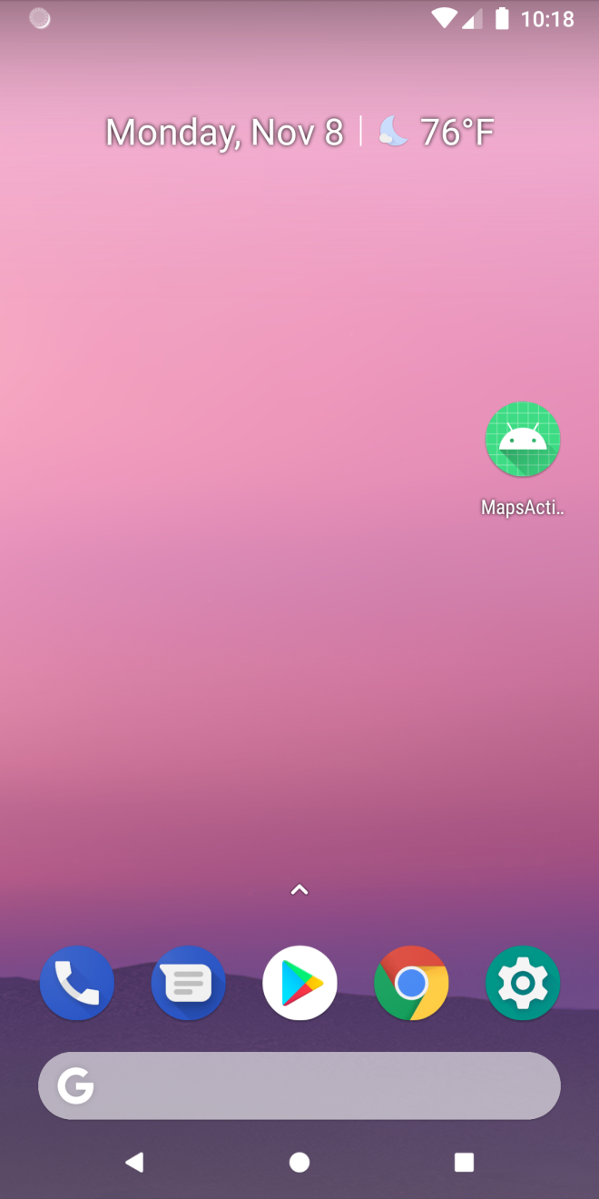
The mobile phone view
app

Slide 11
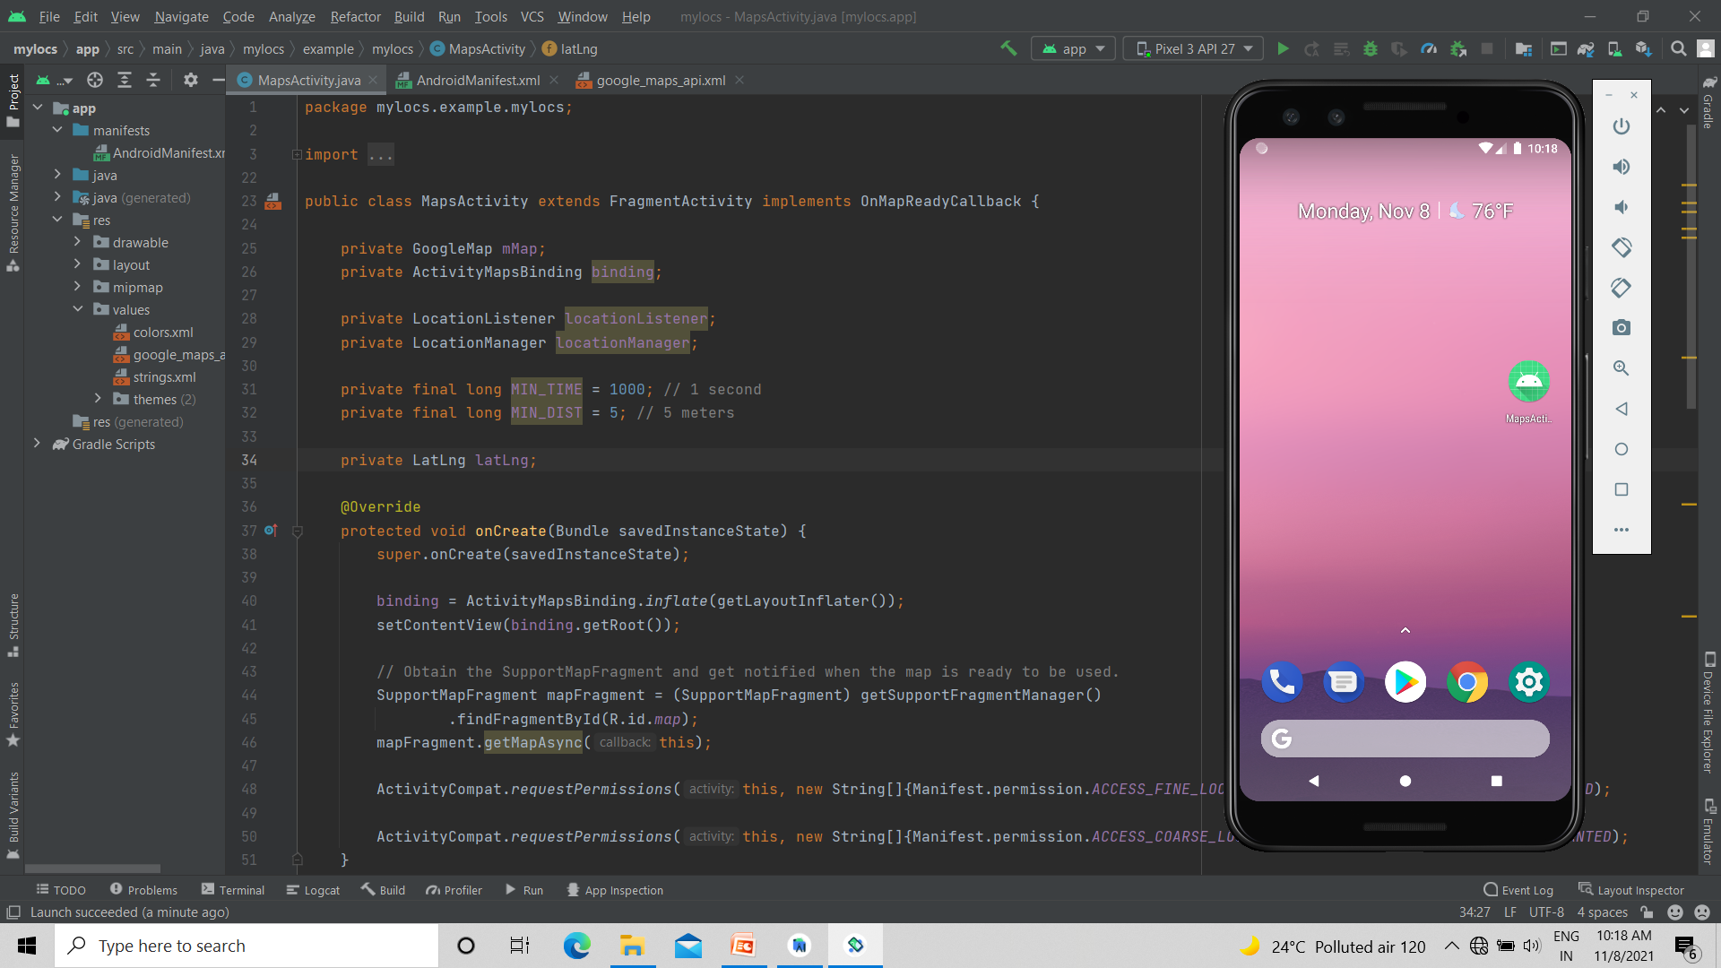
With the code

Slide 12
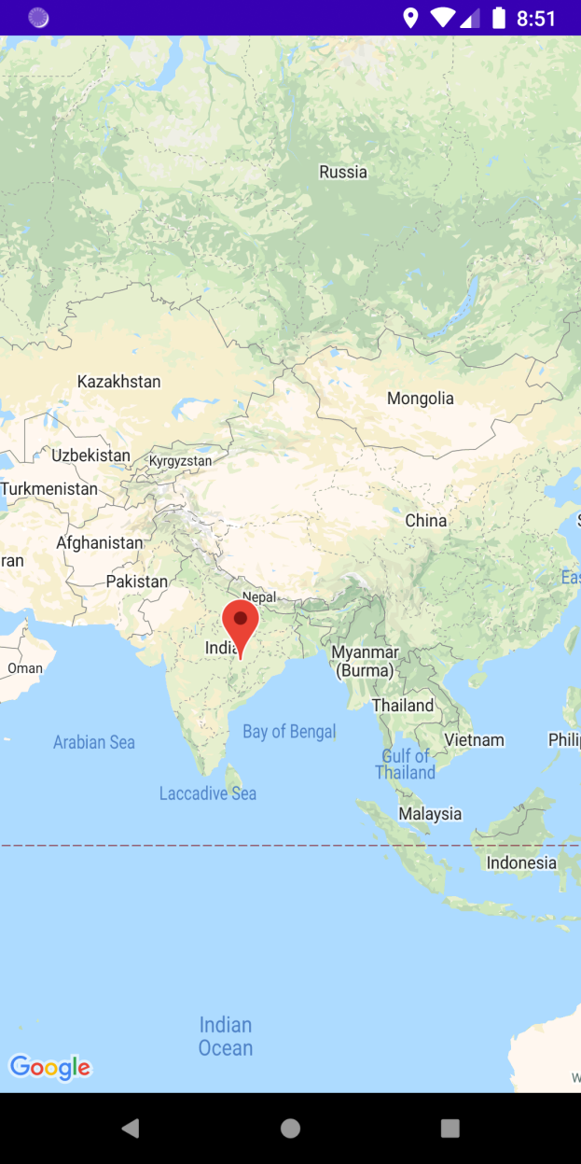
When you open app , you will see map pointing your current location ie, where you are .

Slide 13
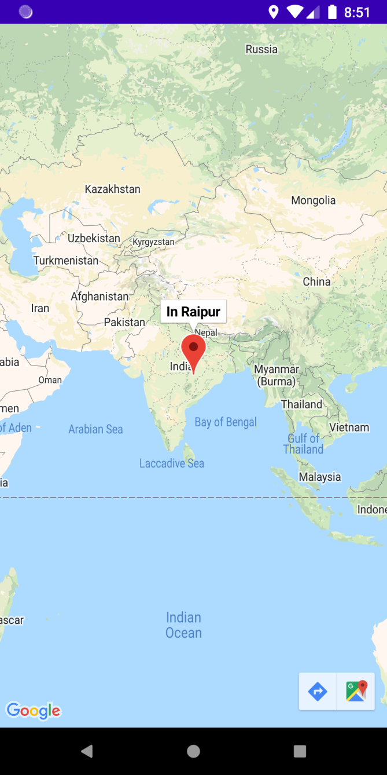
When you click or touch the pointer it will display the name of that particular place .

Slide 14
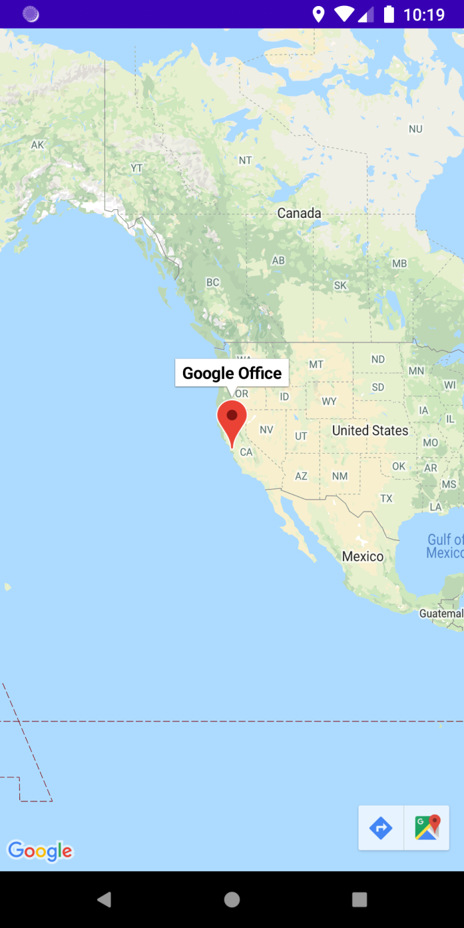
You can also search for places …
Showing the result of search “ where is google office ? “

Slide 15
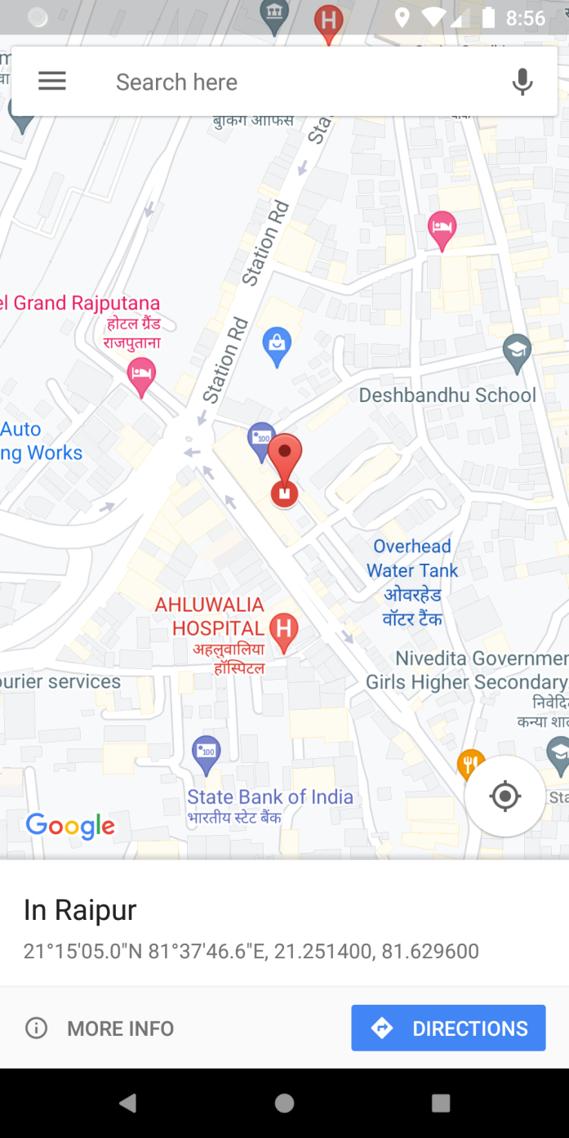
You can also get to see nearby places surrounding .

Slide 16
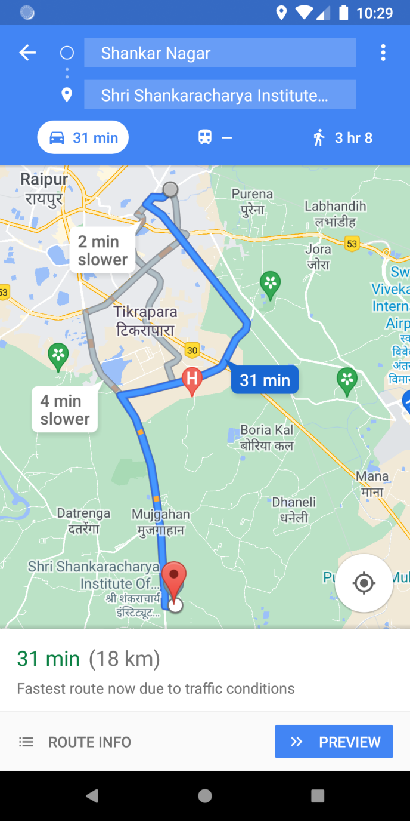
You can get directions to go from your location to other location .

Slide 17
Work Flow Diagram

Slide 18
Start
Turn ON GPS/Location
checking
OFF
Close App
ON
Fetching all location details
Showing current location

Slide 19
Data Flow Diagram

Slide 20
Level 0 - DFD
Current location
Directions
Location
Teller
App
Latitude Longitude
Nearby Places
Search for Places
Track your Mobile

Slide 21
Result & Conclusion
The objective of this project i.e. an Android application is to provide location tracking functionality for Android device.
This project supports the Android OS only and makes communication with the phone through GPS. The scope of this project includes the security of the architecture as well as the accuracy of tracking unit.

Slide 22
References
Web Resources
www.google.com
www.thecodecity.com
www.nevonprojects.com
www.youtube.com

Slide 23
Thank You ….

